Slide 1

“Creating a winning circle in sustainable urban freight and optimizing inner city logistics”
BSR-Electric case study 3.1
Thomas Troels Smith
Municipality of Hoeje Taastrup, Denmark

Slide 2
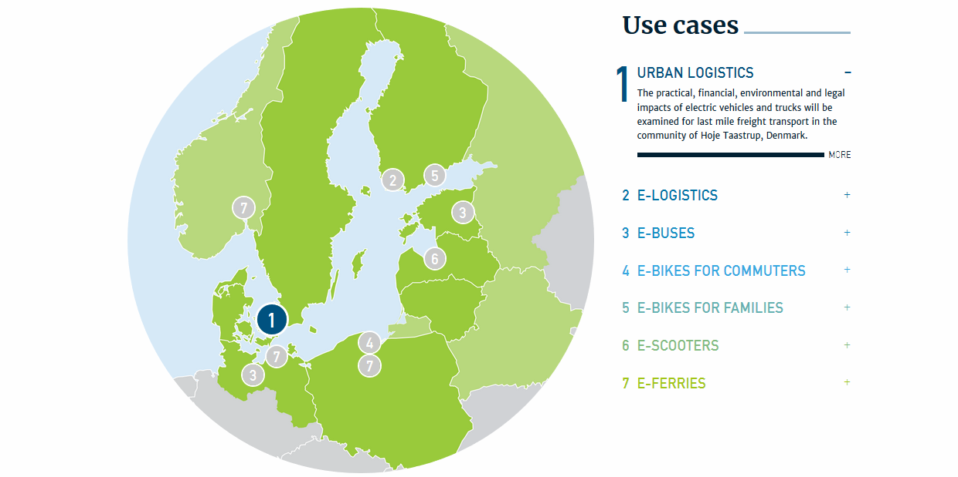
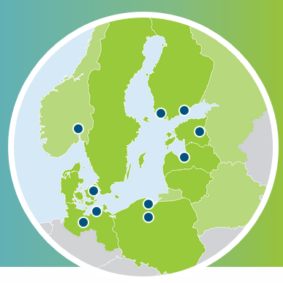

Slide 3
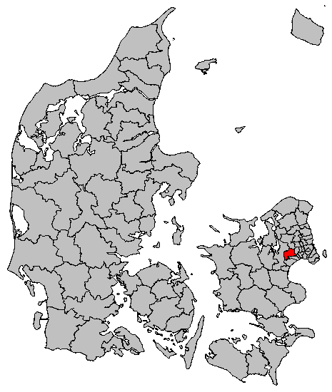
Hoeje Taastrup Municipality
An urban Municipality of Copenhagen
Part of the Region Capital of Denmark
25 min drive south west from the City of Copenhagen
App 79.000 square km, App. 50.000 inhabitans
Mainly middle – low income area
Growing business area
Transport & Logistik Center
  One of the the largest transport hubs in Denmark
  5-6 big logistic and shipping companies situated in the Transport Center

Slide 4
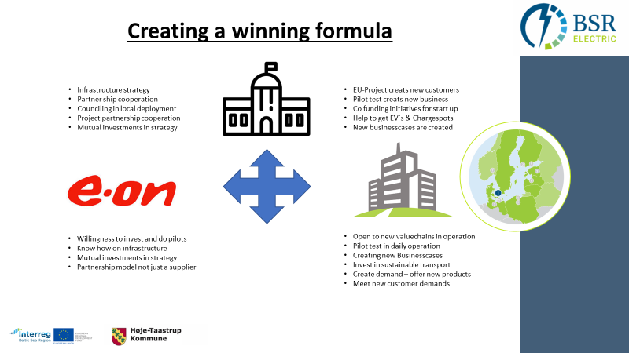

Slide 5
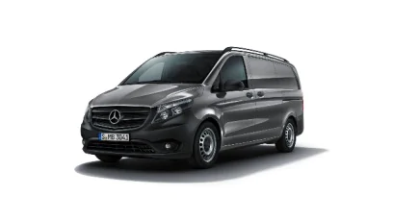

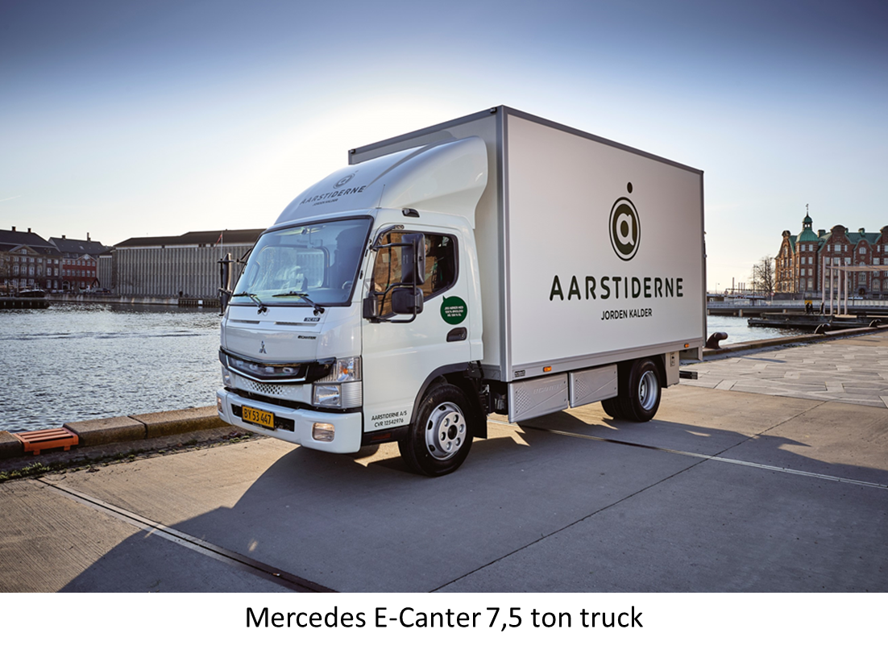
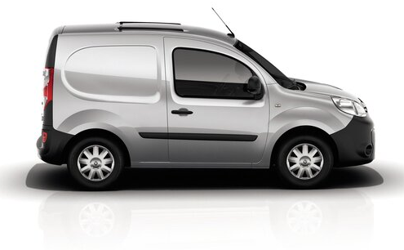
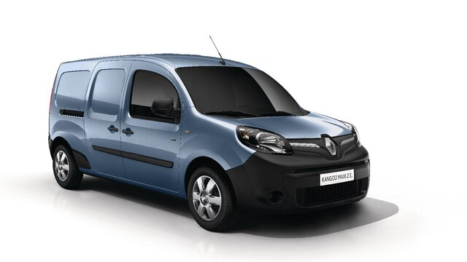
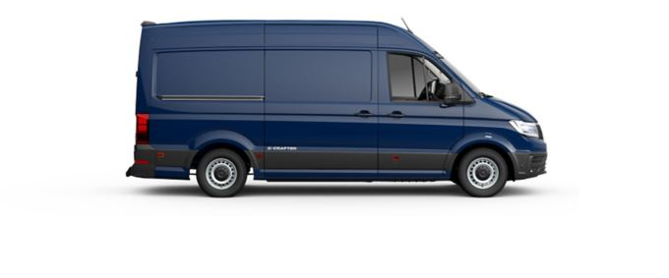
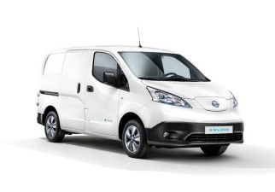


Mercedes E-Vito
Renault Kangoo
Volkswagen E-Crafter
Renault Kangoo Maxi
Nissan E-NV200

Slide 6
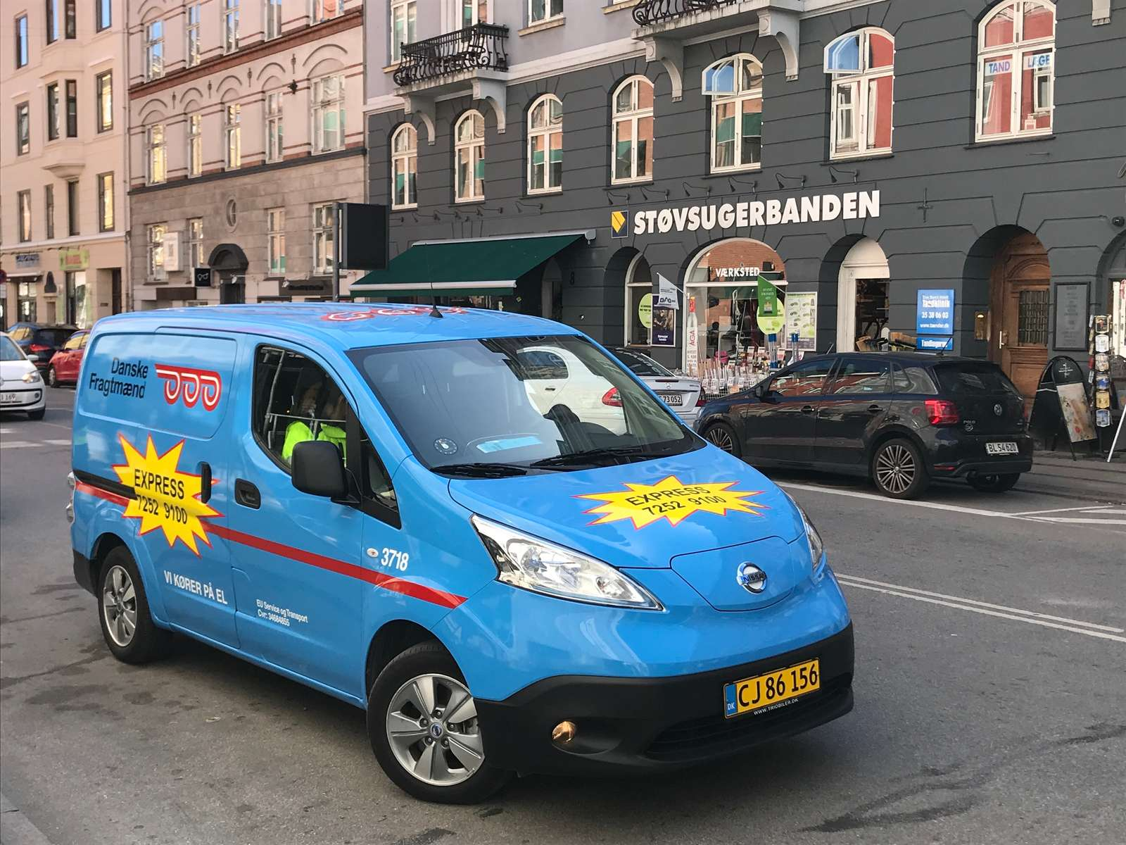

Pilotcase 1:
Distribution of high-end goods to shops around the urban city of Copenhagen by E-vans
Packing and loading truck at Transport Center of Hoeje Taastrup
Daily deliveries of goods
5 different E-van models tested
Local infrastructure and chargespot deployed for daily charging
Test
Period: + 12 months
E-vans: Renault Kangoo, Renualt Kangoo Maxi, Volkswagen E-crafter, Mercedes E-vito, Nissan NV-200
Charging: 3,7 kW & QC-charging 50 kW

Slide 7
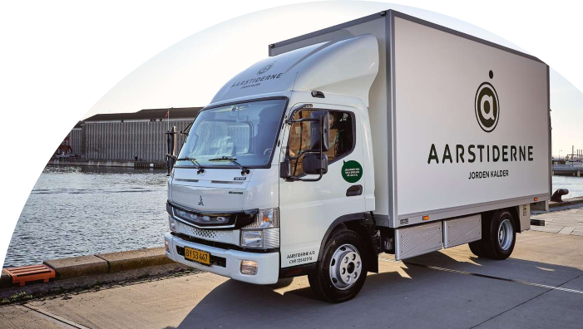

Pilotcase 2:
Distribution of ecologic vegetables, fresh fruit and meal boxes between depos and to end customers in Copenhagen
Mercedes E-Canter
First E-truck in Denmark of 7,5 ton.
Test
First time E-Truck in Fleet
Period: 6 months
Daily trips of 80-120 km
Charging: 3,7 kW home & QC-charging 50 kW

Slide 8
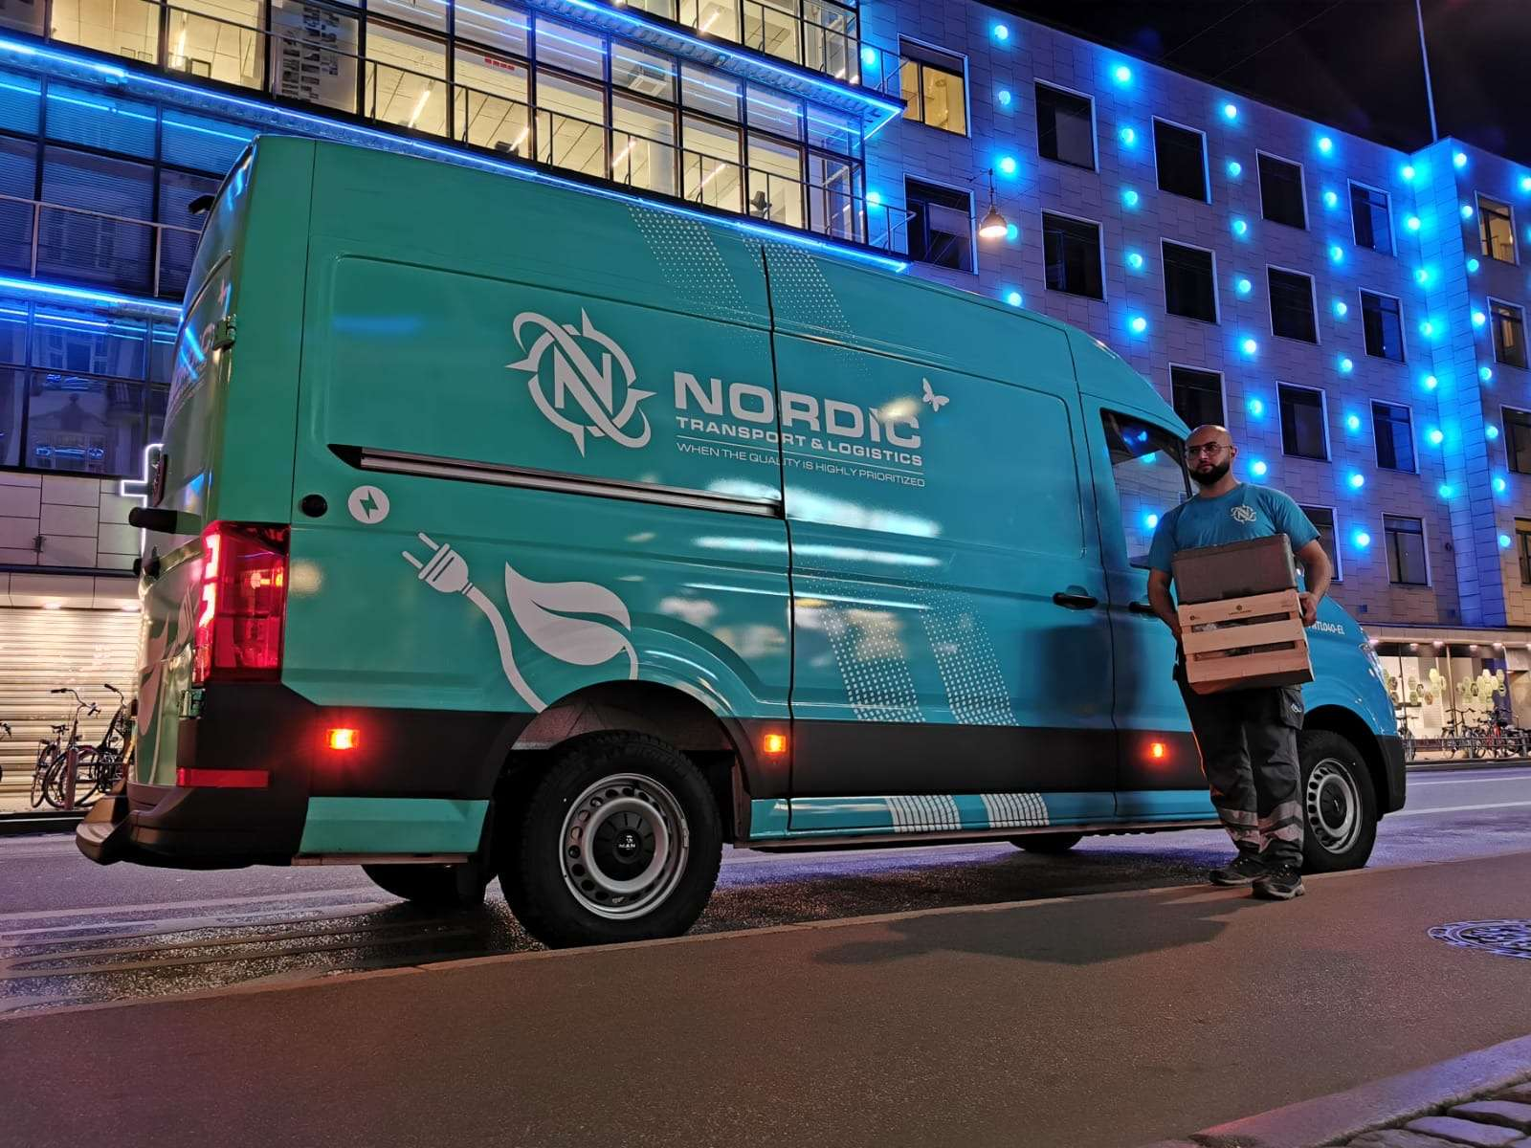

Pilotcase 3:
Last mile delivery of mealboxes to end users in Copenhagen
Night time deliveries
Daytime delivery of fresh fruit for companies in Copenhagen
MAN E-TGE
DC-Charging from parking lot (24 kW)
3500 kg. Max payload
Test
First time testing E-Vans in their fleet
Period: 6 months
Daily trips of 60-120 km
DC 40 kW

Slide 9
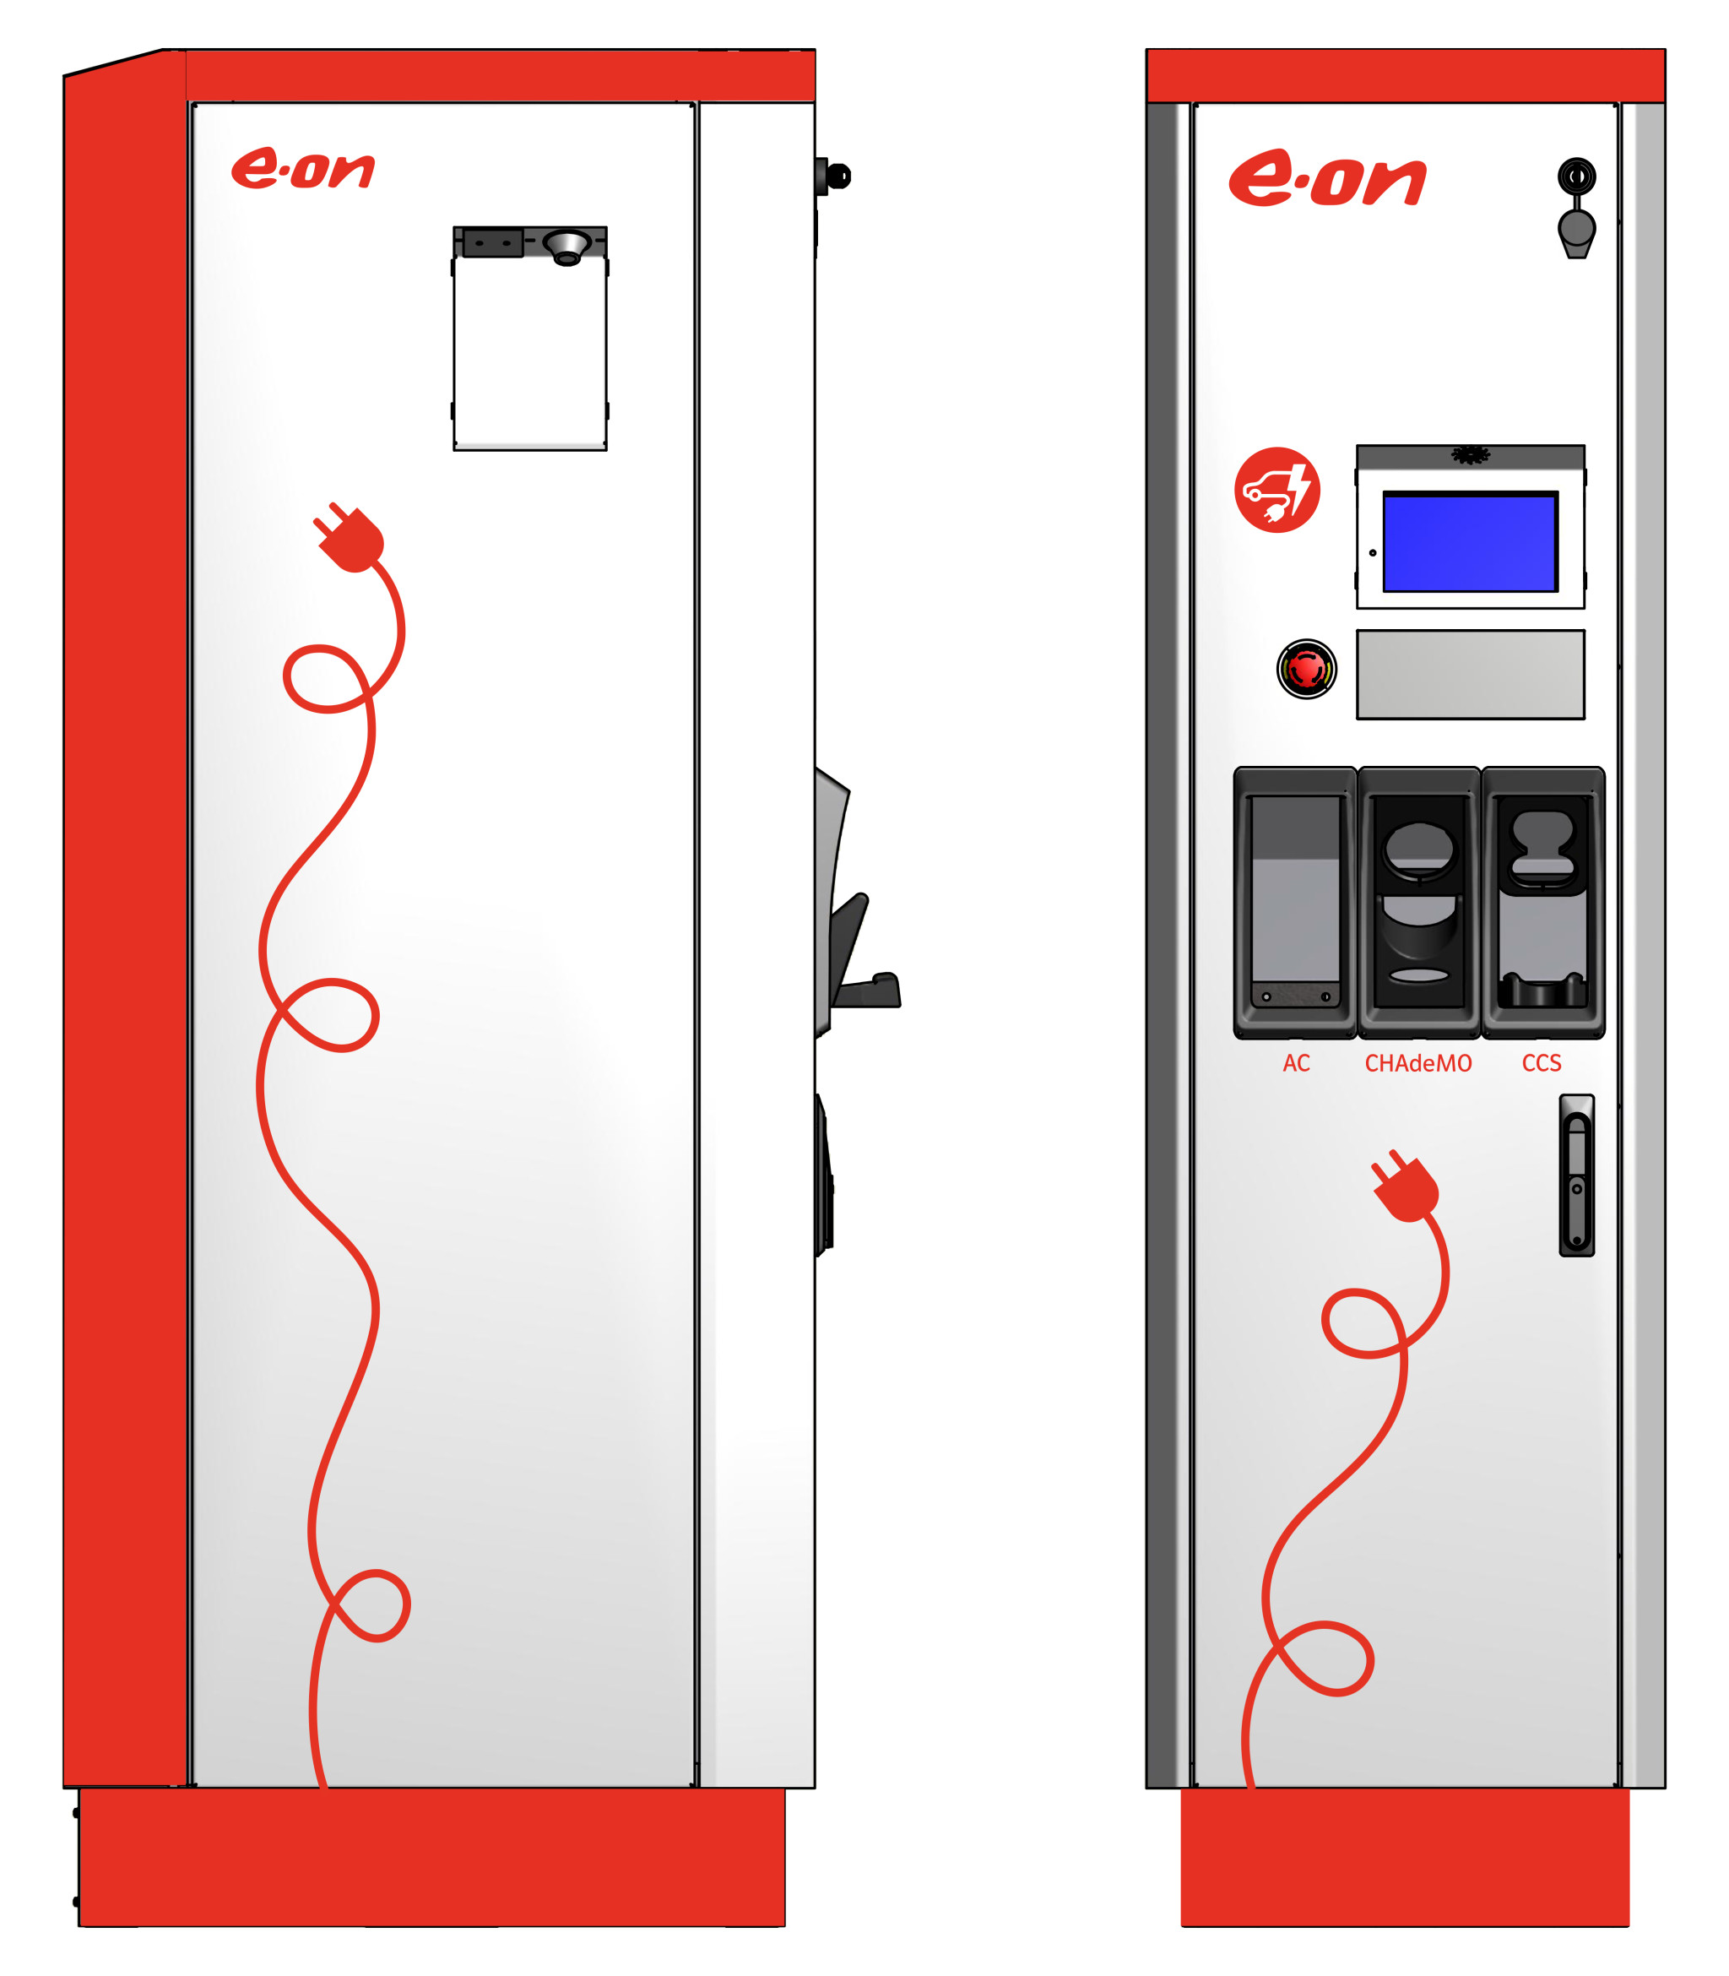



Slide 10

What major results have we achieved
A Quick Charge 50-kWh chargespot has been installed in cooperation with IKEA Denmark
3 Partners with successfull implementation and new strategy for E-mobility underway
  All 3 partners wants to invest more in E-mobility – already now
  8-10 new E-vans will be procured in 2020
  New customers and new way of doing business is generated
Cooperation between pilotcompany and Mercedes => First E-Canter in Denmark
Positive business cases are now a reality – New contracts are signed for 3 years
Test of all available E-vans in marked has been successfull (and challenging)
Politcal support now in place – Benefit in kind program in Denmark is now underway in 2020 (value about 4 mio. €)

Slide 11
Pro´s
Demand has started to show in the Danish marked
New E-vans are comming now
Political focus => Supporting the national climate goals
TCO´s are improving over the next years
Daily drives are less than 150 km on many logistic routes
Municipalities can start the positive circles
Investments will follow from pilots
Policymaking is changing now – to benefit the zero emission deliveries
Benefit in kind programs to promote commercial marked of E-vans has now been announced in Denmark
Positive stories create good vibes – snowball effect
Con´s
Cost is still to high compared to ICE-vans
Marginal business – more positive business cases has to be detected and published in marked
Range limitations in batteries limits the daily operations
Limited models in the marked
Infrastructure for commercial vehicles are limited
Transmission will cost – customers have to pay a premium price
Charging deployment is costly
Cultural change takes time
E-mobility changes workflows and way of thinking

Slide 12
Thank you

